Slide 1

Hospitality and Tourism’s Current State of Recovery and What YOU Can Do

Slide 2

Impact from the Pandemic
As an Industry Leader I focus on 3 key areas:
Associate Engagement
Guest Satisfaction
Financial Success
East Side Experience: Since Covid began we have had to make the hard decision to close many hotels in order to save cost due to no demand and revenue

Slide 3
The Road to Recovery
We cannot take a negative approach to what has happened. It is not anyone’s fault, a good leader is someone that stays resilient in the face of adversity.
Staying optimistic and resilient is key by creating opportunities thru PIVOTING across industries. Examples; seeking a job shadow and broaden your scope to relocate for an internship or ultimately earning a job
Once a vaccine is truly in place, business and leisure travelers will be more confident to return to the road as long as the restrictions are lifted
It is critical that we help each other thru the pandemic and rebounding will take everyone to work together with organizations like the American Hotel & Lodging Association and US Travel Association
Hotel operators need to have health and safety protocol in place.

Slide 4
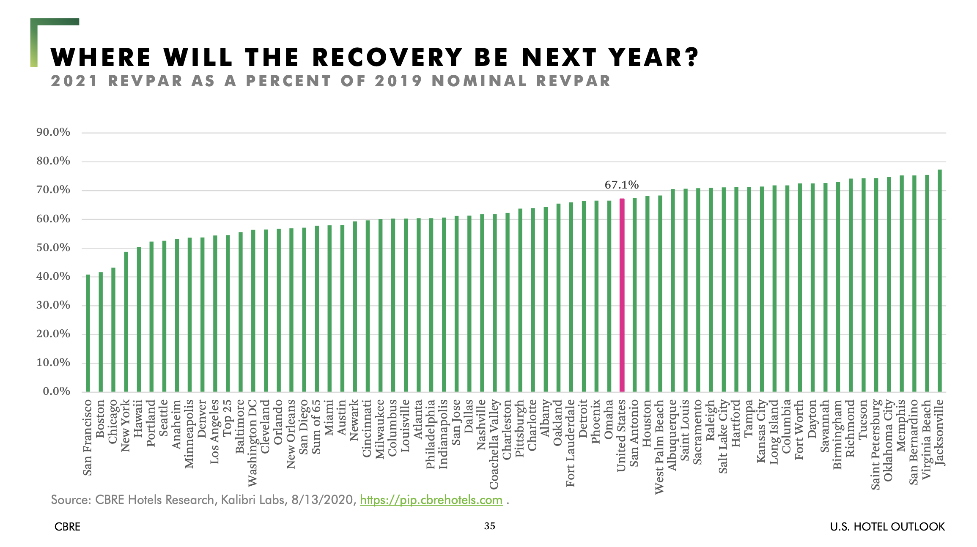
Each state assesses the level of pandemic activity, which allows them to manage and set varying executive orders of opening.

Slide 5
Opportunities for the Hospitality Industry over the next year
Guests are not ready to travel until there is more confidence that the virus is under control. Working remote is the way they accomplish what they need to. Not having a personal connection is missing.
Pent Up Demand: Leisure travel, specifically in a drive market has more potential demand before business travelers, they have been restricted for too many months and they will want to create an experience for their families
Securing base business with other segments like airline crew is a focus for hotels. Even though the number of flights maybe limited, shifting to secure cargo crews are another demand generator.
Remain in close contact and build your network, being transparent with employees and guests to know when we may return to business

Slide 6
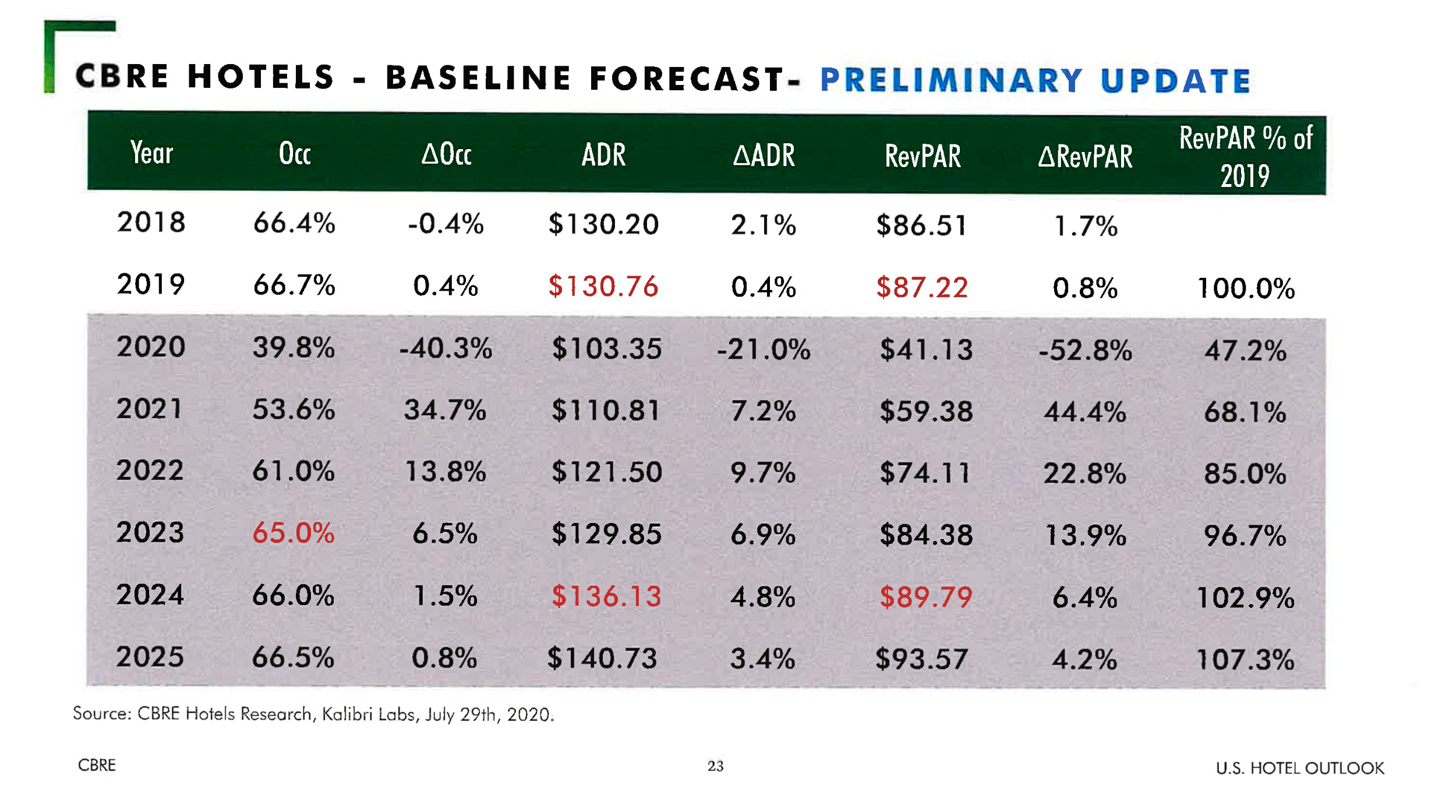

Slide 7
How are We Managing the New Post Covid Norms
Many properties are closed and cautious to reopen until 2021. There needs to be a level of sustainable occupancy to drive top line revenue.
Anticipate at least a 3 year recovery to rebuild our demand with several new norms by offering services via a mobile app platform for all offerings, even F & B
Creating productivity efficiencies that will be sustainable for example how we deliver rooms service in a fast casual or pantry type pick up model
Getting back to the basics and doing what makes our guest feel comfortable to do 3 things…
Wear a Mask
Stay socially distant with appropriate signage
Sanitization Washing Stations
Start Something New…my new business venture

Slide 8
David Salcfas
Phone-908-482-1075 david@iyouhospitalityconsulting.com
Thank you for allowing me to “Inspire” YOU
? What Questions do YOU have ?

